Slide 1
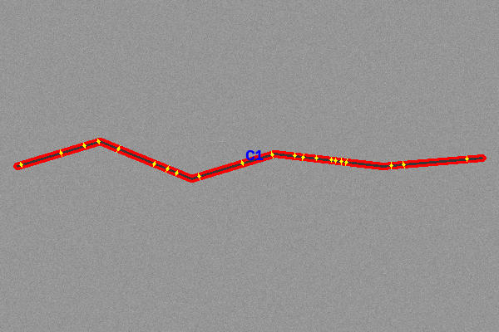
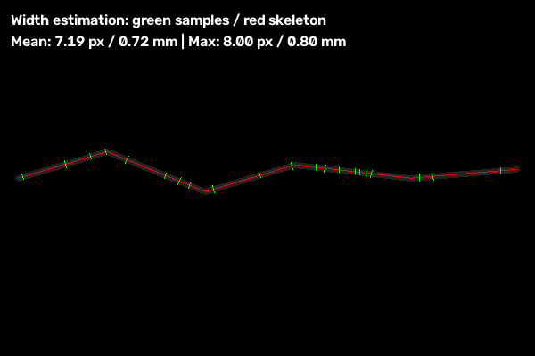
MCA MAJOR PROJECT
OpenCV-Based System for Crack Identification and Width Estimation
PATEL MAN VISHNUBHAI
Enrollment No. 25IC03CA053
Guide: Dr. Srikant Singh
School of Engineering, P P Savani University
Notes:
Introduce the project: a web application that finds cracks in photos and measures their length and width using classical computer vision.

Slide 2
Contents
1
Project Overview
2
Technology & Design
3
Processing Pipeline
4
The Nine Models
5
Database
6
Implementation
7
Testing & Results
8
Wrap-up
Notes:
Eight parts. The slide numbers show where each part starts.

Slide 3
Project Overview
01
What the system is and why
Notes:
Part one: the idea.

Slide 4
Project at a glance
Item | Detail
Name | Crack Identification and Width Estimation
Purpose | Find cracks, measure length and width, grade severity
Surfaces | Concrete, asphalt, roads, walls
Front end | HTML5, Bootstrap 5, JavaScript
Back end | Python, Flask, OpenCV, NumPy, scikit-image
Database | MongoDB (in-memory fallback)
Notes:
Summary of the project from the project details file.

Slide 5



Cracks are early warning signs
Slow
Subjective
Poorly recorded
Manual gauge and tape
Differs by inspector
Little visual evidence
Notes:
Inspection is slow, subjective and poorly recorded.

Slide 6






Objectives
Upload images
Find cracks
Reject non-cracks
Length and width
Convert to mm
Export reports
Keep history
Notes:
Seven objectives from upload to history.

Slide 7



Which model is used?
Classical computer vision + rule-based classifier
Fast
Explainable
No training data
Calibrated
CPU only
Exact geometry
Works directly
Pixels to mm
Notes:
No neural network and no GPU. A classical computer-vision pipeline plus a rule-based severity classifier.

Slide 8
Classical vs deep learning
 | Deep learning | This project
Training data | Large labelled set | None needed
Hardware | GPU | Ordinary CPU
Explainable | Black box | Every stage visible
Width in mm | Not directly | Yes, with scale
Unseen textures | Stronger | Weaker
Notes:
Trade-off: classical is transparent and light, deep learning is stronger on unseen textures.

Slide 9
Technology & Design
02
Tools and architecture
Notes:
Part two.

Slide 10
Technology stack
Component | Technology | Role
Language | Python 3.10+ | Whole back end
Web framework | Flask 3 | Routes, controllers
Computer vision | OpenCV 4.9+ | Image processing
Numerical | NumPy | Matrix maths
Morphology | scikit-image | Skeletonization
Database | MongoDB / Mongomock | Records, fallback
Reports | ReportLab, pandas | PDF and CSV
Front end | Bootstrap 5.3 | Responsive UI
Notes:
All open source.

Slide 11



Technology at a glance
Python
OpenCV
scikit-image
Language
Images
Skeleton
Flask
MongoDB
ReportLab
Web server
Storage
PDF reports
Notes:
Six main building blocks.

Slide 12
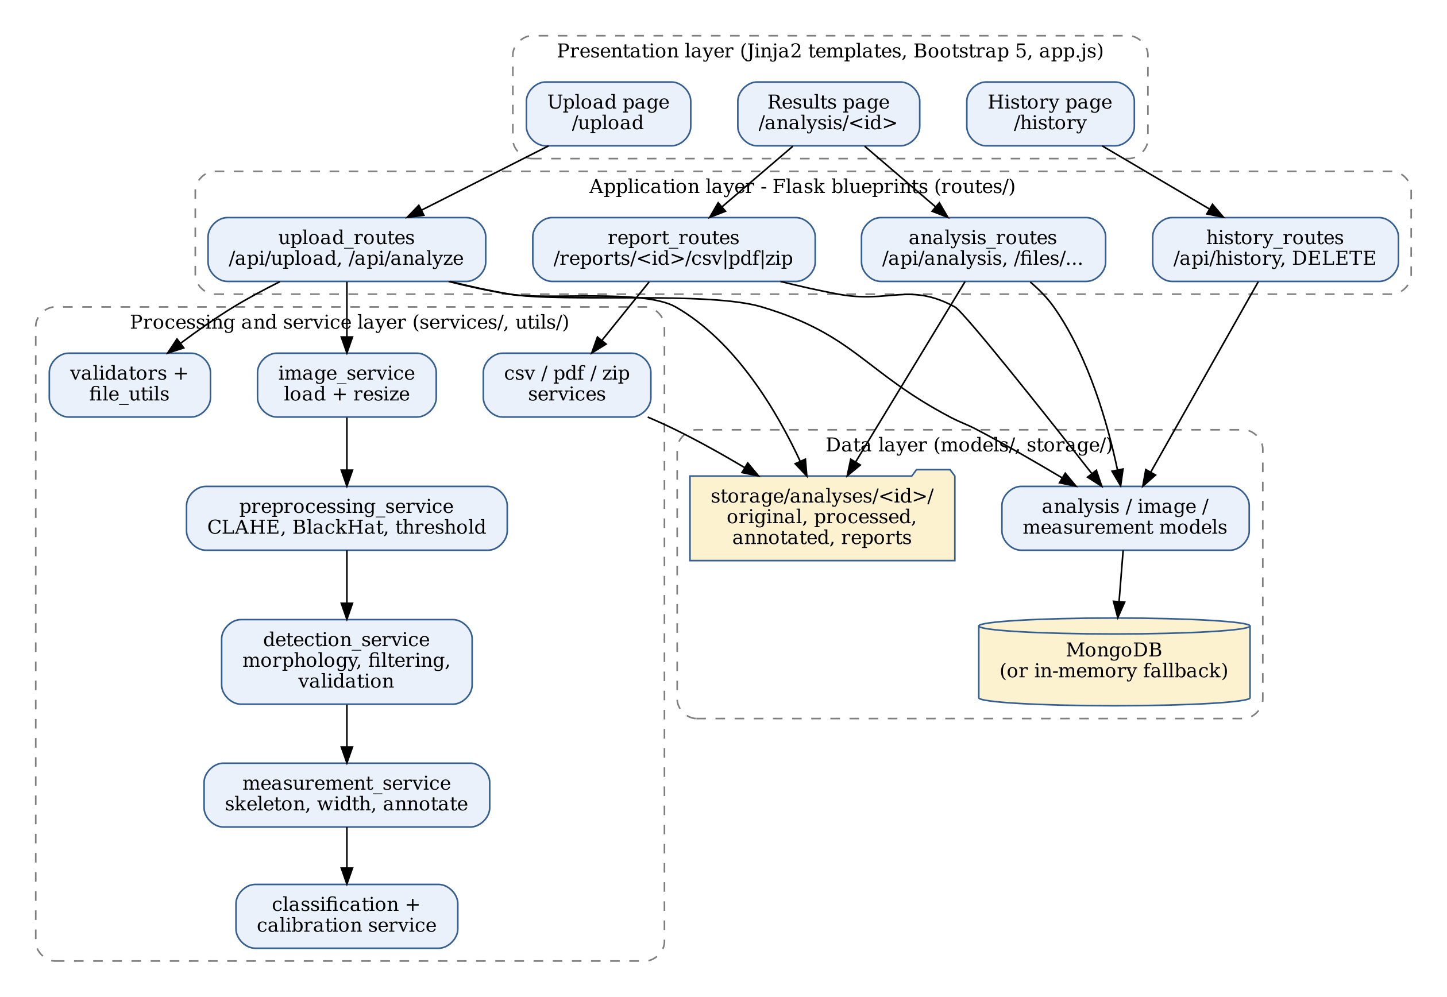
Layered architecture
Presentation
HTML pages, JS
Application
Flask routes
Processing
OpenCV services
Data
MongoDB + files
Notes:
Presentation, application, processing and data layers.

Slide 13



How a user works with it
Upload
Analyse
Review
Export
Choose photos
Automatic
Images and numbers
CSV, PDF, ZIP
Notes:
Upload, analyse, review, export.

Slide 14
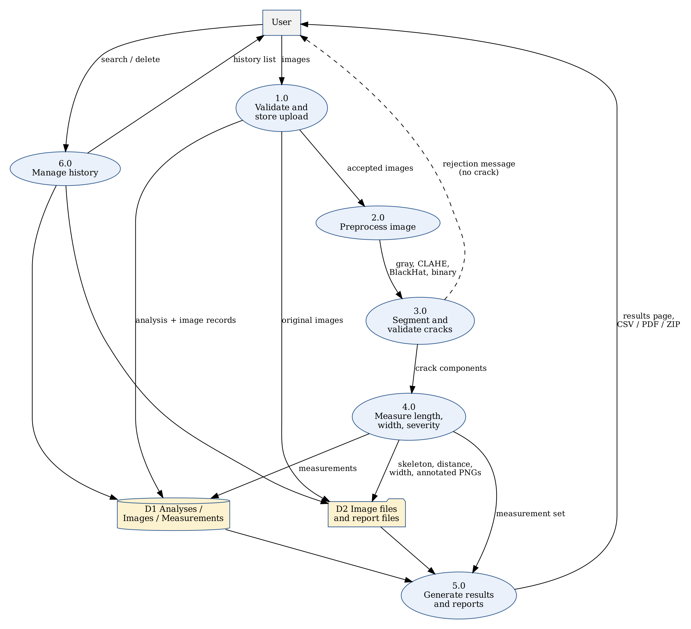
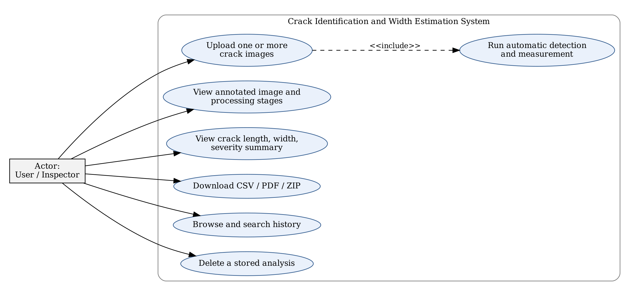
Data flow and use cases
Use cases
Notes:
Level-1 data flow diagram and the use-case diagram.

Slide 15
Processing Pipeline
03
Eleven steps from photo to result
Notes:
Part three.

Slide 16
Pipeline overview
1
Resize
2
Grayscale + blur
3
CLAHE
4
Black-Hat
max 1600 px
5×5 Gaussian
local contrast
dark valleys
5
Adaptive threshold
6
Clean + bridge
7
Geometry filter
8
Unify paths
41×41 window
close gaps
SVD ratio ≥ 3
link nearby parts
9
Skeleton
10
Width
11
Calibrate + draw
1 px centre line
distance transform
mm, annotate
Notes:
Eleven steps. Each saves an image so it can be checked.

Slide 17
Steps 1 to 6: prepare the image
Step | What happens | Setting
1 Resize | Scale down large photos | max 1600 px
2 Grayscale + blur | One channel, less noise | Gaussian 5×5
3 CLAHE | Even out shadows | clip 2.0, 8×8 tiles
4 Black-Hat | Show dark narrow lines | ellipse 21×21
5 Adaptive threshold | Crack pixels = white | 41×41 window
6 Clean + bridge | Fill gaps, drop specks | min area 30 px
Notes:
Resize, remove noise, boost contrast, highlight dark lines, threshold and clean.

Slide 18
Steps 7 to 11: measure the crack
Step | What happens | Setting
7 Geometry filter | Reject round blobs | ratio ≥ 3.0
8 Unify paths | Join nearby pieces | link distance 25 px
9 Skeleton | Centre line = length | scikit-image
10 Width | Distance to the edge | 2 × radius
11 Calibrate + draw | Pixels to mm, annotate | 10 px = 1 mm
Notes:
Filter shapes, join pieces, thin to a line, measure width, convert to mm.

Slide 19
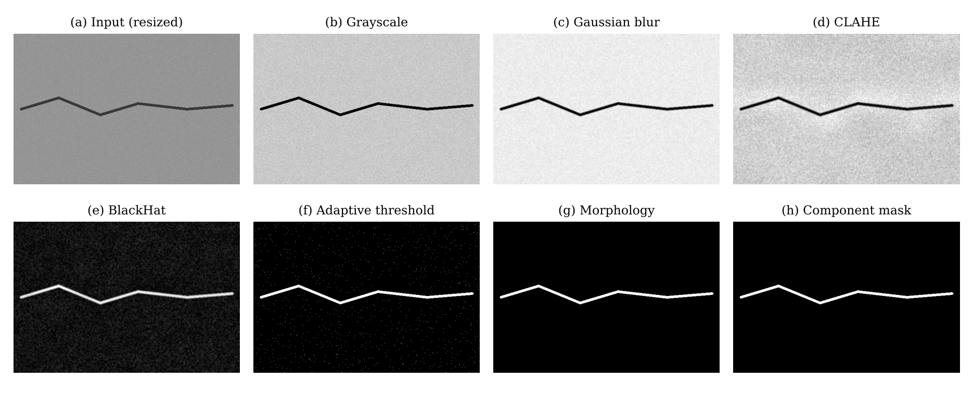
Every stage is saved as an image
Notes:
These are the real images produced by the application for one synthetic crack.

Slide 20
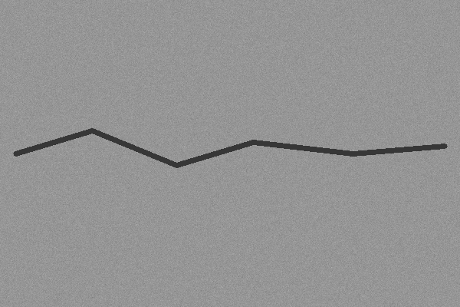
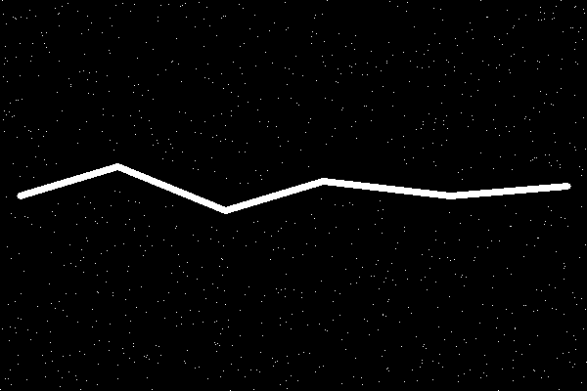
Threshold: crack becomes white
Grayscale
After threshold
Notes:
The adaptive threshold adapts to uneven light.

Slide 21

Clean up and keep crack shapes
Threshold
Cleaned
Crack mask
Rule | Value
Smallest piece kept | 30 px
Long and thin (ratio) | ≥ 3.0
Notes:
Specks are removed, then only long thin shapes are kept.

Slide 22
Images with no crack are rejected
Test image | Result
Plain wall | Rejected
Round blob | Rejected
Text image | Rejected
Texture only | Rejected
Crack image | Accepted
4 of 4
non-crack images rejected
Notes:
Four non-crack images were tested; all were rejected.

Slide 23
The Nine Models
04
Methods used inside the pipeline
Notes:
Part four.

Slide 24
Nine models at a glance
No | Model | Job
1 | CLAHE enhancement | Even out light
2 | Black-Hat morphology | Find dark thin lines
3 | Adaptive Gaussian threshold | Crack vs background
4 | Morphological closing | Bridge small gaps
5 | Component linking graph | Join one crack
6 | SVD geometric filter | Reject round blobs
7 | Skeletonization | Length
8 | Distance transform | Width
9 | Rule-based severity | Good / Medium / Heavy
Notes:
Nine methods, each with one clear job.

Slide 25
Models 1 to 3: find the crack
1
2
3
CLAHE
Black-Hat
Adaptive threshold
clip 2.0, 8×8 tiles
closing − image, 21×21
41×41 Gaussian window
Evens out shadows and lighting
Isolates narrow dark lines
Handles uneven lighting
Notes:
Enhance contrast, isolate dark lines, then threshold locally.

Slide 26
Models 4 to 6: clean and verify
4
5
6
Gap bridging
Component linking
SVD filter
morphological closing
link distance 25 px
ratio σ1 / σ2 ≥ 3
Joins cracks broken by stones
Merges pieces into one crack
Rejects gravel and pits
Notes:
Close gaps, link pieces, reject blobs by shape.

Slide 27
Models 7 to 9: measure and grade
7
8
9
Skeletonization
Distance transform
Severity rules
scikit-image skeletonize
width = 2 × radius
Good, Medium, Heavy
One-pixel centre line gives length
Median = mean width, P95 = max
Compares width with thresholds
Notes:
Skeleton for length, distance transform for width, rules for severity.

Slide 28
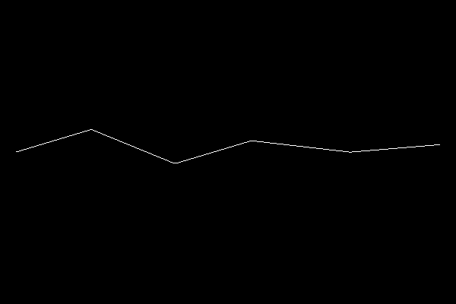
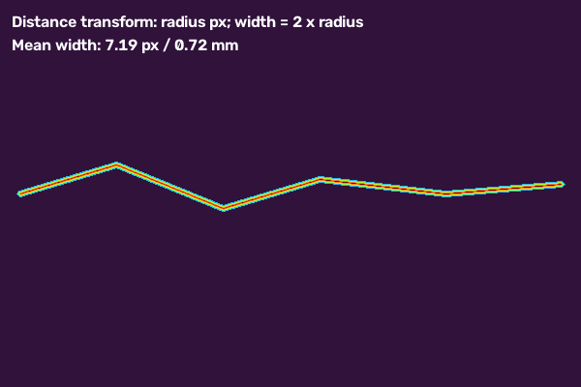
Skeleton and distance transform
Skeleton
Distance transform
Width samples
609.6 px
7.19 px
8.00 px
crack length (60.96 mm)
mean width (0.72 mm)
maximum width (0.80 mm)
Notes:
The skeleton is a one-pixel centre line; the distance transform gives the radius to the edge.

Slide 29
Worked example: a 5 px bar
1 | 1 | 1 | 1 | 1 | 1 | 1 | 1 | 1 | 1 | 1 | 1 | 1 | 1 | 1 | 1 | 1 | 1 | 1 | 1
1 | 2 | 2 | 2 | 2 | 2 | 2 | 2 | 2 | 2 | 2 | 2 | 2 | 2 | 2 | 2 | 2 | 2 | 2 | 1
1 | 2 | 3 | 3 | 3 | 3 | 3 | 3 | 3 | 3 | 3 | 3 | 3 | 3 | 3 | 3 | 3 | 3 | 2 | 1
1 | 2 | 2 | 2 | 2 | 2 | 2 | 2 | 2 | 2 | 2 | 2 | 2 | 2 | 2 | 2 | 2 | 2 | 2 | 1
1 | 1 | 1 | 1 | 1 | 1 | 1 | 1 | 1 | 1 | 1 | 1 | 1 | 1 | 1 | 1 | 1 | 1 | 1 | 1
width = 2 × distance
2 × 3.0 = 6.0 px
true bar width: 5 px
Distance values across the bar (centre row highlighted)
Notes:
Distance values rise to 3 at the centre, so width = 2 × 3.0 = 6.0 px, one pixel above the true 5 px.

Slide 30
Measurements and units
Measure | How | Unit
Length | Sum of skeleton links | px and mm
Mean width | Median of 2 × radius | px and mm
Maximum width | 95th percentile | px and mm
Area | Crack pixels | px² and mm²
Scale | Default 10 px = 1 mm | px per mm
Notes:
Length sums skeleton links, widths use median and 95th percentile, mm = px divided by pixels-per-mm.

Slide 31



Severity: Good, Medium, Heavy
Good
Medium
Heavy
≤ 3 px
3 – 8 px
> 8 px
≤ 0.30 mm
0.30 – 0.80 mm
> 0.80 mm or area ≥ 5000 px²
Notes:
Software label based on mean width and area. It is not a structural safety verdict.

Slide 32
Database
05
Three collections
Notes:
Part five.

Slide 33


Three collections
Analysis
Image
Measurement
One upload batch
One photo
One crack
If MongoDB is offline the app keeps records in memory, so it still works.
Notes:
Analyses contain images; images contain cracks.

Slide 34
Analysis collection
Field | Meaning
analysis_id | Unique id of the session
status | Uploaded, Processing, Completed, Failed
total_images | Images in the batch
total_detected_regions | Cracks found in the batch
pixels_per_mm | Scale, default 10
severity_thresholds | Good / Medium / Heavy limits
Notes:
Key fields of the analysis record.

Slide 35
Image collection
Field | Meaning
image_id | Unique id of the image
analysis_id | Link to the batch
original_filename | Name of the uploaded file
resize_scale | Scale applied on load
workflow_times | Time per step in seconds
processed_paths | Paths of all stage images
Notes:
Key fields of the image record.

Slide 36
Measurement collection
Field | Meaning
crack_id | Id of the crack
skeleton_length_px / mm | Centre-line length
mean_width_px / mm | Median width
max_width_px / mm | 95th percentile width
contour_area_px / mm2 | Crack area
severity | Good, Medium or Heavy
Notes:
Key fields of one crack record.

Slide 37
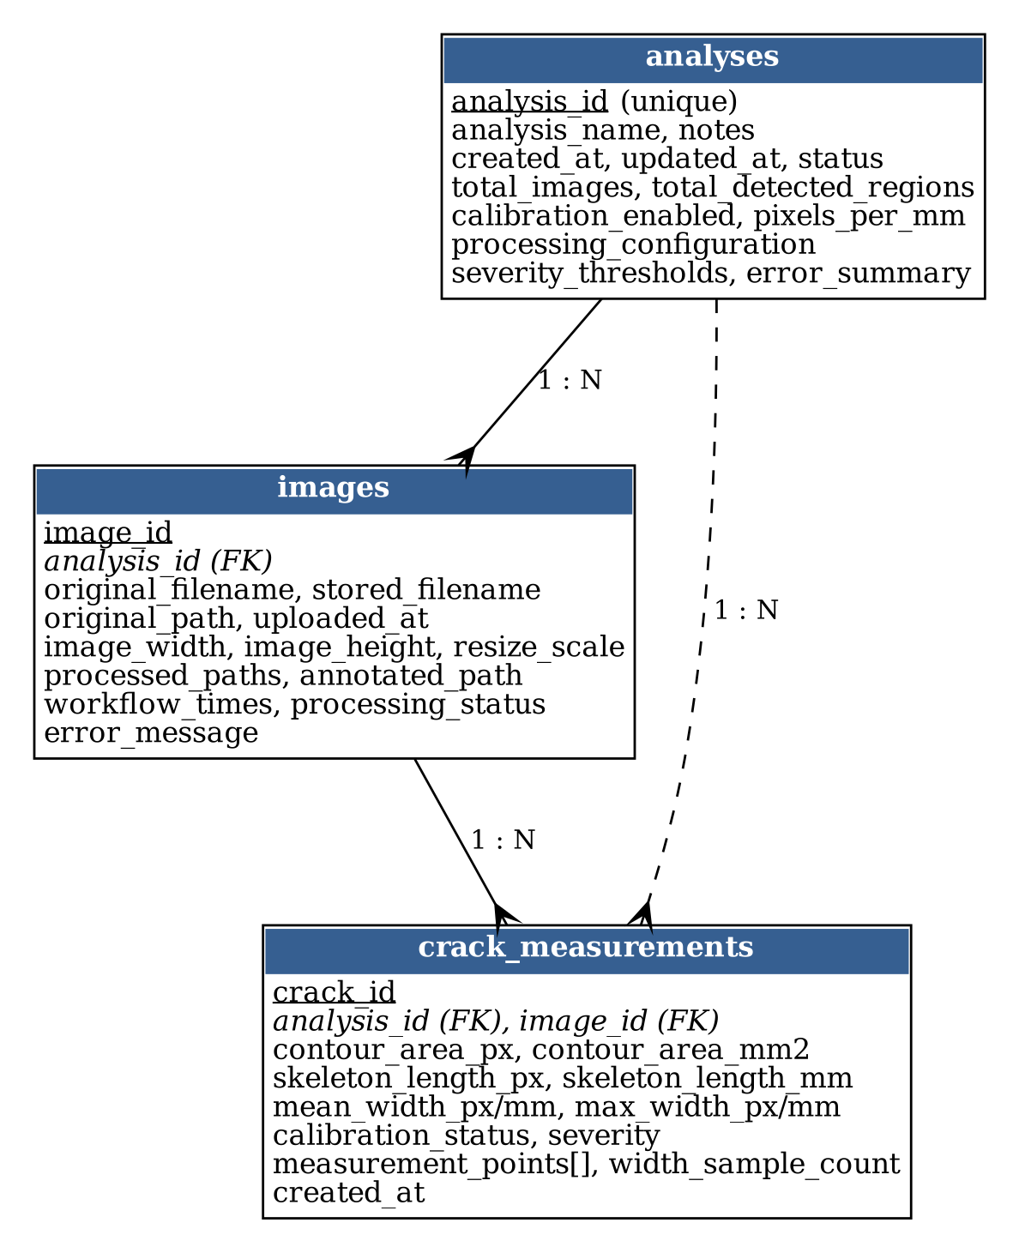
Entity relationship diagram
Notes:
Analysis has many images; each image has many cracks.

Slide 38
Implementation
06
Project layout and user interface
Notes:
Part six.

Slide 39
Project folders
Folder | Holds
models/ | Database and record handling
routes/ | Web page and download endpoints
services/ | Image processing and reports
templates/ | HTML pages
static/ | CSS and JavaScript
tests/ | Automated tests
storage/ | Uploaded and result files
Notes:
Each folder has one responsibility.

Slide 40
The services folder
File | Job
preprocessing_service | CLAHE, blur, Black-Hat, threshold
detection_service | Find, filter and link cracks
measurement_service | Skeleton, width, length
calibration_service | Pixels to millimetres
classification_service | Good / Medium / Heavy
csv, pdf, zip service | Report export
Notes:
The services folder contains the processing logic.

Slide 41
Code size by folder
Notes:
About 1,990 lines in total.

Slide 42
Two main pages
Page | Address | Use
Upload | /upload | Start a new analysis
History | /history | Open past inspections
Results | /analysis/<id> | Images, table, downloads
Notes:
Upload to start, History to revisit.

Slide 43
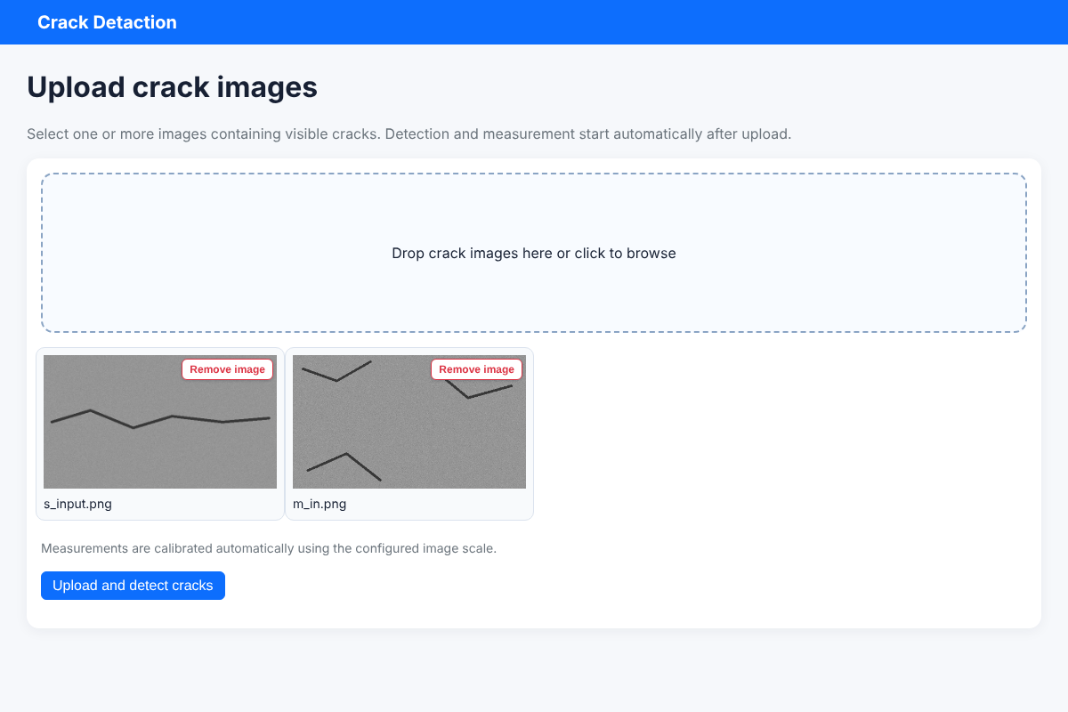
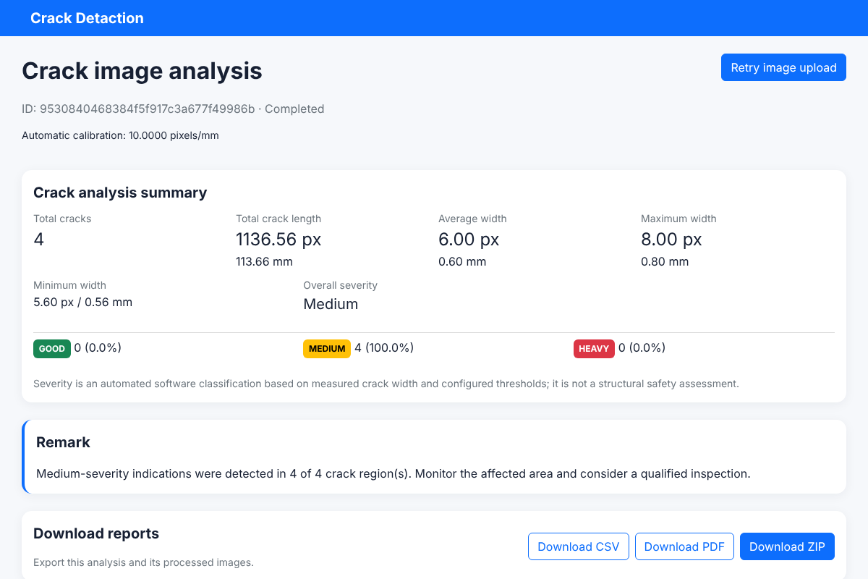
Upload page and results page
Upload
Results summary
Notes:
Screenshots use synthetic test images.

Slide 44
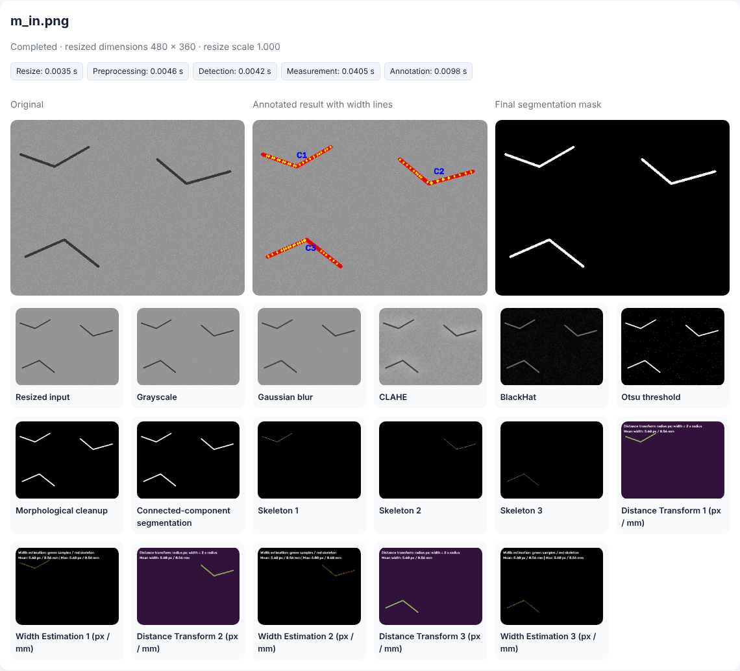


Results page: image by image
Original + annotated
Final crack mask
All stage images
Time per stage
Notes:
Each image shows the original, the annotated result, the mask and every stage.

Slide 45
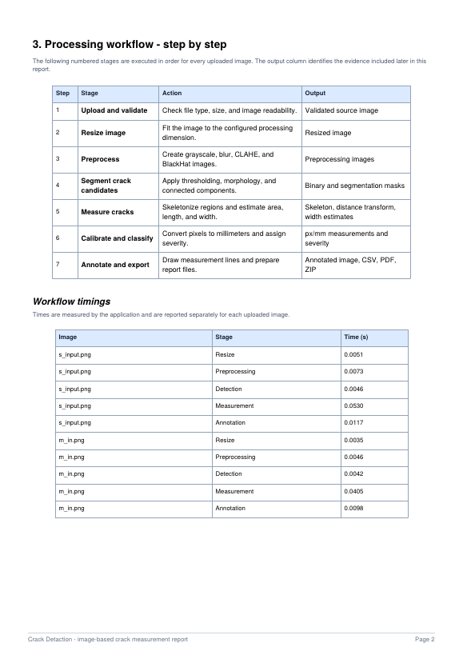
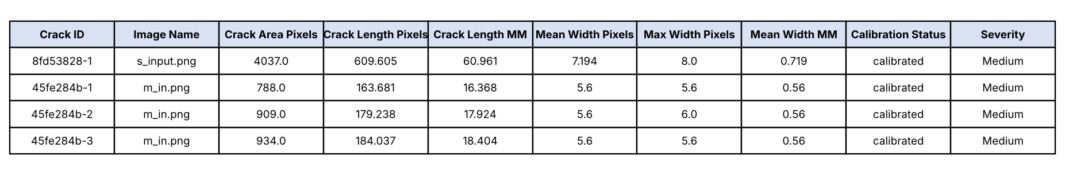
Reports: CSV, PDF, ZIP
34
33
35
CSV columns
PDF pages
files in ZIP
Notes:
A two-image test produced a 34-column CSV, a 33-page PDF and a ZIP of 35 files.

Slide 46




How to run
Option A
Option B
Open
Test
Double-click run_crackscope.bat
Activate the environment, run python app.py
http://127.0.0.1:5000
Run pytest
Notes:
Two ways to start the application.

Slide 47
Testing & Results
07
What was measured
Notes:
Part seven. All numbers come from running the code on synthetic images.

Slide 48
Testing summary
16 / 16
automated tests passed
4 / 4
non-crack images rejected
0.16 s
per 1600 × 1200 image
Notes:
16 automated tests passed; four more checks covered the browser flow and exports; two experiments.

Slide 49
Width accuracy
±0.6 px
mean width error
−7 to +12 %
relative error
Notes:
Bars of known width on a noisy background; the measured mean follows the true width.

Slide 50
Error for each width
Notes:
Largest error +0.6 px; thin bars have the largest relative error.

Slide 51
Faint cracks are missed
≥ 35
grey levels needed
5 / 5
detected at every noise level
Notes:
Below about 30 grey levels of contrast nothing is detected; above that the length is correct.

Slide 52
Length error depends on angle
+6–7 %
at oblique angles
≈ −1 %
at 0°, 45°, 90°
Notes:
At 0, 45 and 90 degrees accurate; elsewhere 6 to 7 percent too long. Known limitation.

Slide 53
Speed
Notes:
Measurement is the largest share of the time.

Slide 54
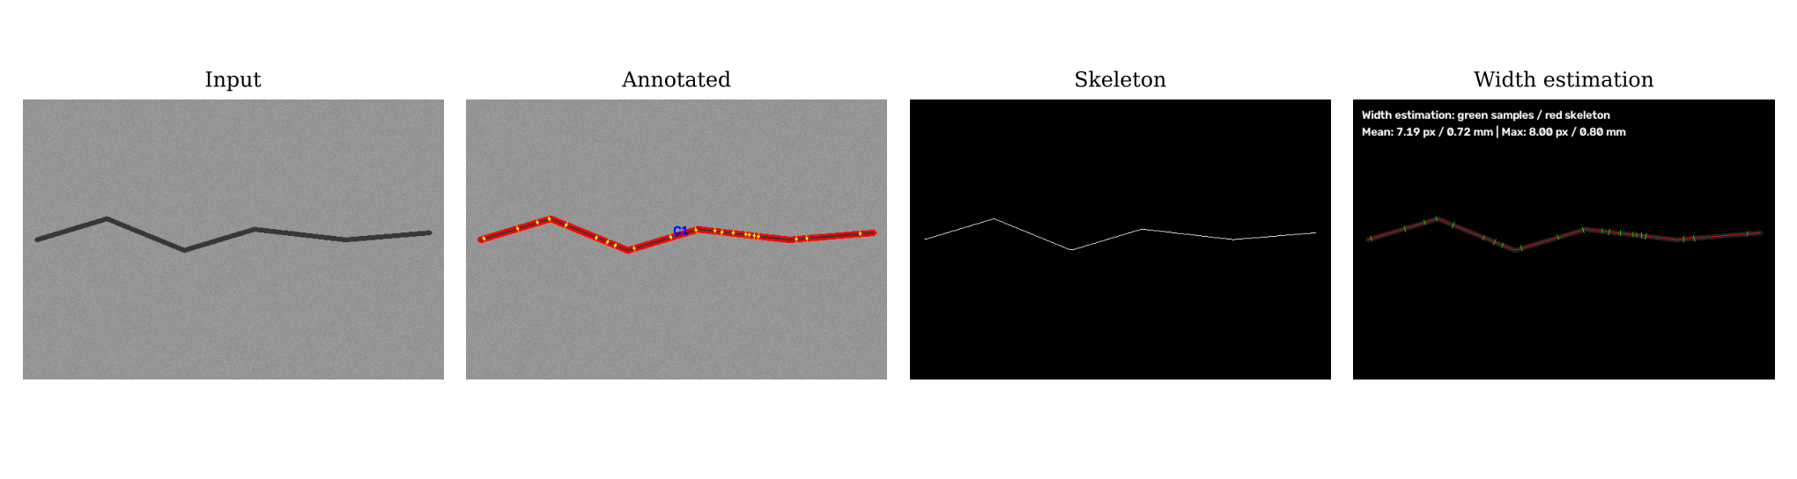
Result on a test image
609.6 px
7.19 px
Medium
length = 60.96 mm
mean width = 0.72 mm
severity label
Notes:
Input, annotated result, skeleton and width image.

Slide 55
Wrap-up
08
Limits, future work, conclusion
Notes:
Part eight.

Slide 56
Known limitations
Limitation | Detail
Synthetic tests only | No real-photo benchmark yet
Fixed scale | 10 px = 1 mm, not resize-aware
Faint cracks | Missed under ~30 grey levels
Oblique length | +6–7 % too long
No login | For local use only
Notes:
Evidence is synthetic, scale is fixed, faint cracks are missed, no login.

Slide 57



Future scope
Real datasets
Fix length
Per-image scale
Hybrid model
Deploy
Notes:
Real datasets, length fix, per-image scale, hybrid model, deployment.

Slide 58
Conclusion
0.6 px
< 0.2 s
16 / 16
width accuracy (synthetic)
per 1600 × 1200 image
automated tests passed
Detects and measures cracks
Every stage is visible
CSV, PDF and ZIP reports
Notes:
Detects and measures cracks with no training data, shows every stage, exports reports.

Slide 59
Thank you
Questions?
PATEL MAN VISHNUBHAI · 25IC03CA053
Notes:
Thank the audience and invite questions.

